Slide 1
“CSC CODE A BIT-LIT” Data Visualization Team-23
https://github.com/piyushP7pravin/CSC-Code-A-Bit-Lit
LOVE TYAGI
GitHub : lovetyagi-17
LinkedIn : love-tyagi-b4a487150
PIYUSH PRAVIN
GitHub : piyushP7pravin
LinkedIn : piyushP7pravin

Slide 2
Project analysis slide 2
Project Analysis
Data visualization refers to presenting data in a graphical or pictorial form, such as a pie chart. Visualizations allow audiences to recognize patterns more quickly. Interactive displays enable decision-makers to drill down through the layers of detail. This changes perspectives so that users can review the facts behind the analysis.
ANALYSIS
REPORT GENERATION
PROJECT
TRENDS OF DATA
DEEP INSIGHTS
https://github.com/piyushP7pravin/CSC-Code-A-Bit-Lit

Slide 3
Overview
DATASET INFO
Numeric | 1
Categorical | 22
Boolean | 0
Date | 0
Text (Unique) | 1
Rejected | 0
Unsupported | 0
Repo Structure
Main Program File
CSC_data_visualization_LOVE_PIYUSH.ipynb
Working Demo
HTML_Ev
head.html
Plots -> report_data
VARIABLE TYPES
Number of variables | 24
Number of observations | 5217
Total Missing (%) | 0.0%
Total size in memory | 978.3 KiB
Average record size in memory | 192.0 B
REPO LINK
https://github.com/piyushP7pravin/CSC-Code-A-Bit-Lit

Slide 4
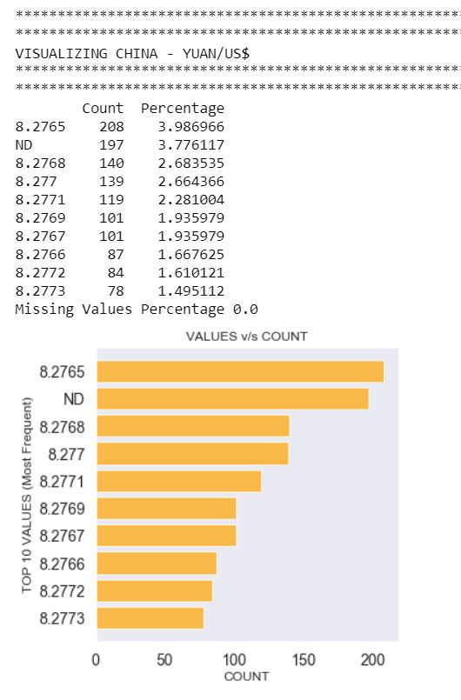
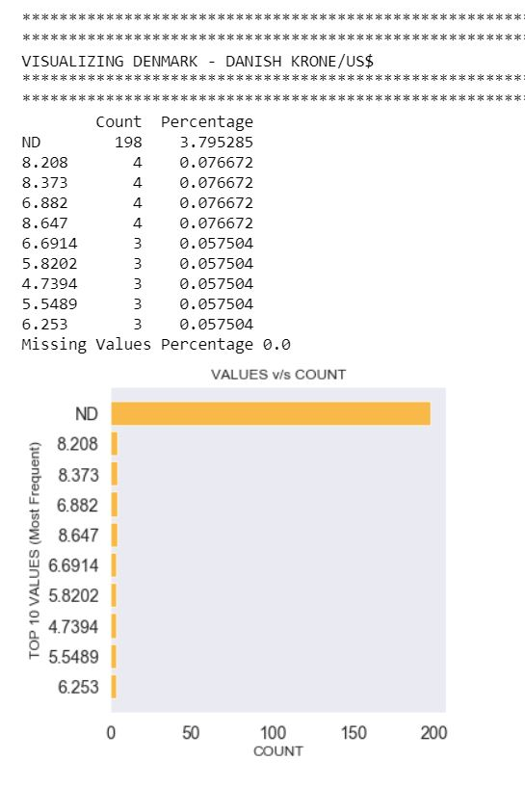
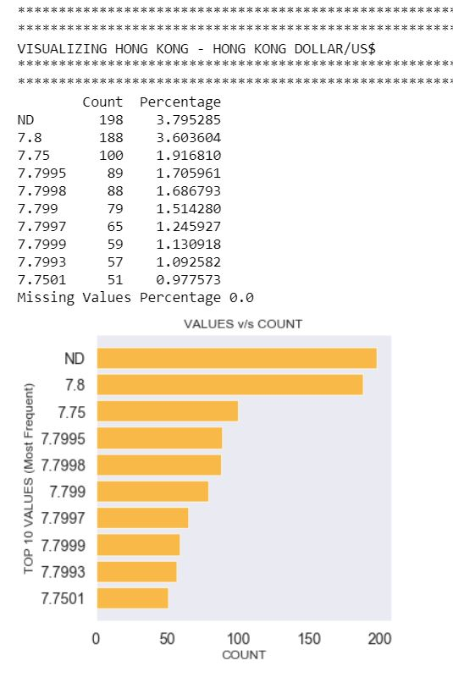
EDA Column Variables (Before Data Cleaning)
Few Samples Rest on repo
https://github.com/piyushP7pravin/CSC-Code-A-Bit-Lit

Slide 5
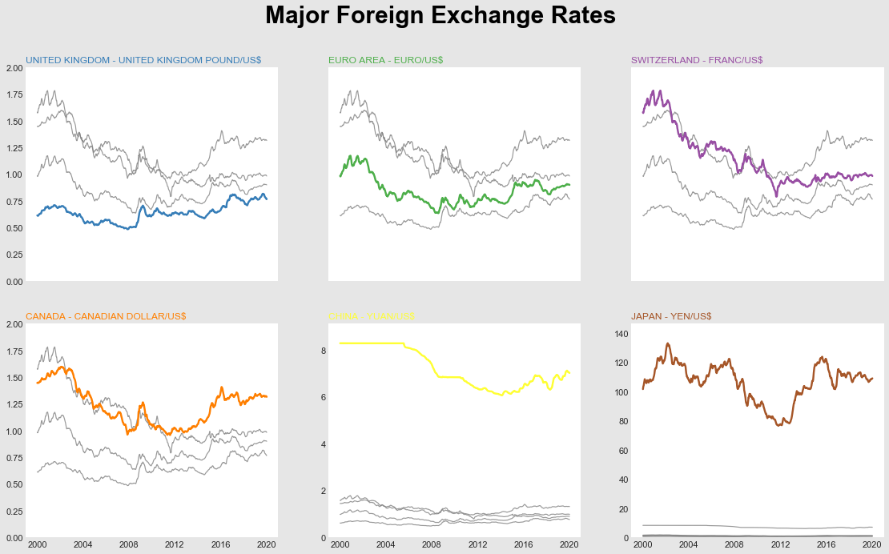
https://github.com/piyushP7pravin/CSC-Code-A-Bit-Lit

Slide 6
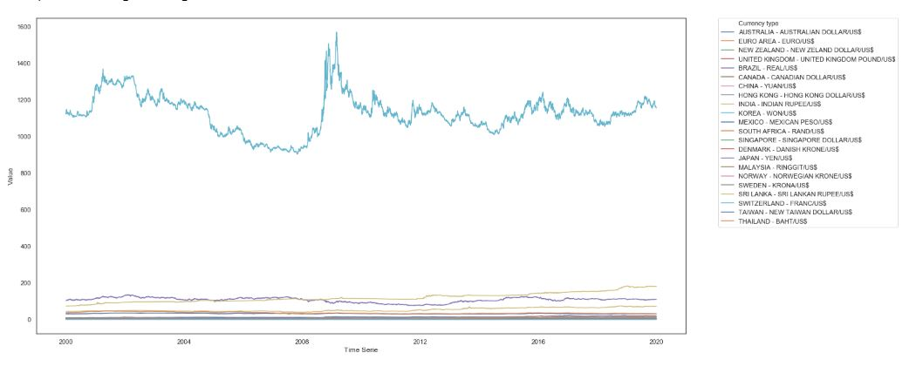
Comapring exchange rates with Time_series
Analysis of exchange rate year wise
https://github.com/piyushP7pravin/CSC-Code-A-Bit-Lit

Slide 7
“CSC CODE A BIT-LIT” Data Visualization Team-23
THANK YOU
https://github.com/piyushP7pravin/CSC-Code-A-Bit-Lit
LOVE TYAGI
GitHub : lovetyagi-17
LinkedIn : love-tyagi-b4a487150
PIYUSH PRAVIN
GitHub : piyushP7pravin
LinkedIn : piyushP7pravin

